Slide 1

Chat bots
6
A computer program that can talk to humans in natural language
Notes:
6

Slide 2
6
Agenda
Introduction
Types of chatbots
History of chatbots
Working of chatbots
NLP
Advantages
Building Alexa skill

Slide 3

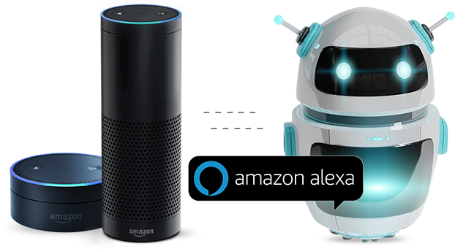
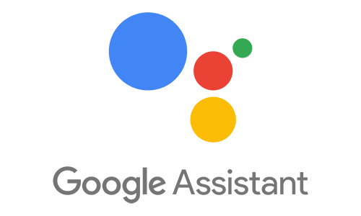
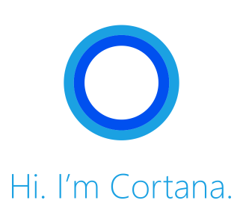

Examples
6
Hi, 👋 I’m NATASHA

Slide 4
6
Introduction
Chat Bot: A computer program that can talk to humans in natural language!
Uses Artificial Intelligence Markup Language (AIML) to represent knowledge.
Can replace a human for monotonous jobs of answering queries, e.g. E-help desk

Slide 5
6
Types Of Chat Bots
Rule-based chatbots
that can respond to specific commands.
Artificial intelligence chatbots
that respond to natural language.

Slide 6
6
How It All Started
Eliza – the first chat bot made by Joseph Weizenbaum in 1966.
Working of Eliza is based on
Knowledge Representation
Pattern Recognition
Substitution of key words into known phrases.

Slide 7
6
Natural Language Processing
Natural language processing (NLP) is the ability of a computer program to understand human speech as it is spoken. NLP is a component of artificial intelligence .
It makes computer to perform useful tasks with the natural languages humans use.
Current approaches to NLP are based on machine learning
The input and output of an NLP system can be −
Speech
Written Text

Slide 8
NLP has 3 specific concepts as follows
6
Entities:
This essentially represents an idea to your chatbot.
For example,it may be a payment system in your E-commerce chatbot.

Slide 9
6
Natural Language Processing
Context representation:
EX : “Ordering Pizza”. Or could include other parameters like “Domino’s: Restaurant”. With context, you can easily relate expectations with the necessity of comprehending the last question.

Slide 10
6
Natural Language Processing
Expectations:
Example: “I want to purchase a white pair of shoes”, and “Do you have white shoes? I want to purchase them” or “show me a white pair of shoes”, is the same: a list of shops selling white shoes. Hence, all user typing text show a single command which is the identifying tag; white shoes.

Slide 11
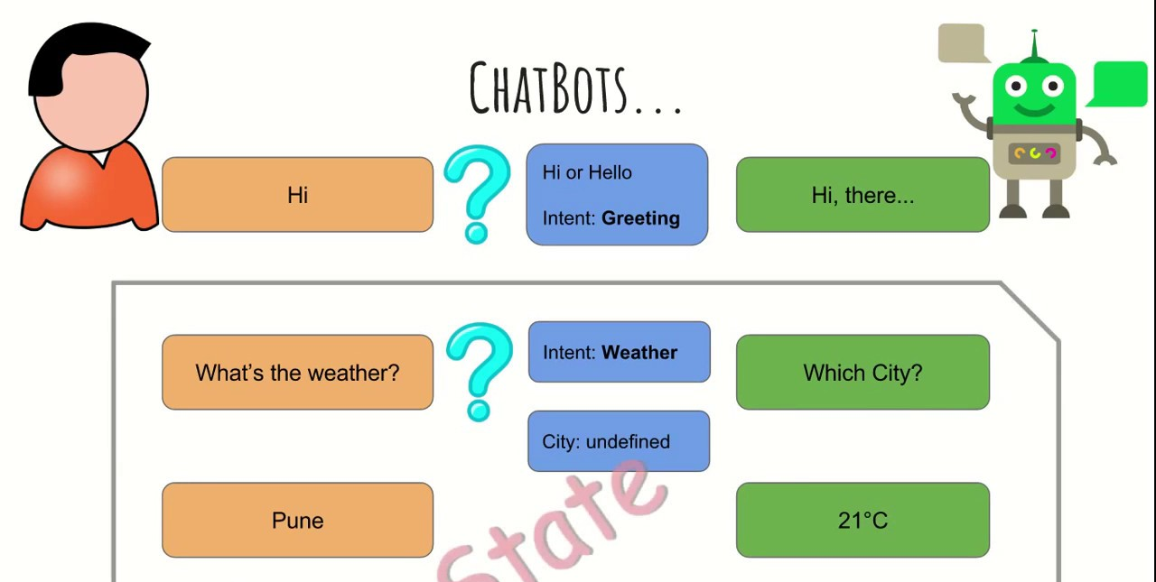
6
Working

Slide 12
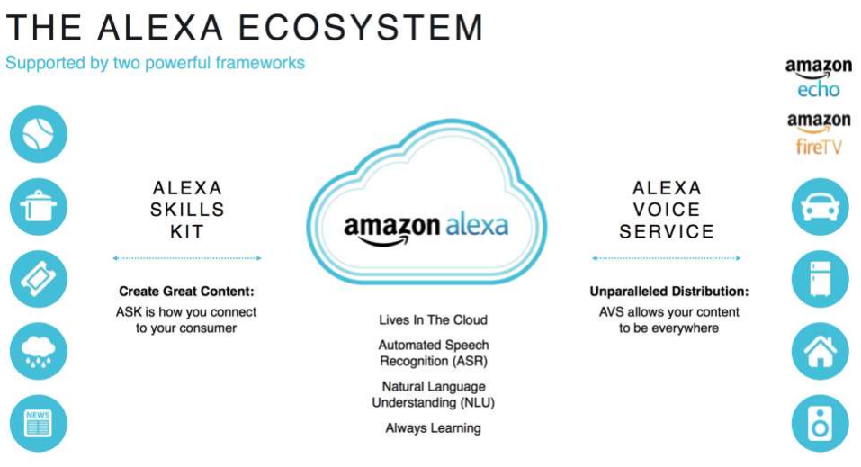
Alexa skill building
6

Slide 13
6
Alexa skill building
What is Alexa Skills Kit (ASK) ?
▸ Collection of self-service APIs
▸ Tools
▸ Documentation
▸ Code samples

Slide 14
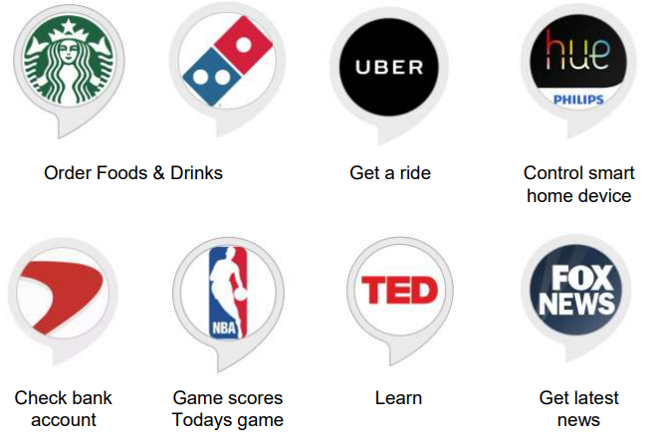
6
What can we build with ASK?

Slide 15
6
Alexa skill building
Alexa Skills Types
▸ Custom Skills
▸ Smart Home Skills
▸ Flash Briefing Skills

Slide 16
Alexa skill building
6
Custom Skills
▸ design your own interaction model.
▸ interaction name is required.
▸ customer need to remember interaction name or invocation phrase.
▸ you can use any server to host custom skill.

Slide 17
Alexa skill building
6
Flash Briefing Skills
▸ only way to add contents to Alexa flash briefing.
▸ Alexa, what’s new?
▸ pre-recorded audio clips andtext-to-speech.
▸ RSS feed format or JSON format.

Slide 18
6
Alexa skill building
Smart Home Skills
▸ built-in interaction model.
▸ natural utterances to control device.
▸ Alexa, turn on living light
▸ You need a cloud service to manage customers smartdevices.
▸ Skill must use AWS Lambda function.

Slide 19
6
Alexa skill building
6 Steps to Build Your First Alexa Skill
▸Step 1: Create your free Amazon Developer Account and
name your skill
▸Step 2: Get Space Geek from the GitHub repository
▸Step 3: Upload code into AWS Lambda
▸Step 4: Configure and test your code
▸Step 5: Customize your Alexa skill
▸Step 6: Fine-Tune and Publish Your Skill

Slide 20
6
Advantages To Use Of Chatbots
Keeping Up with the Trends: Being Present on Messaging Platforms2.
Improved Customer Service
Increased Customer Engagement
Easier Approach to Global Markets
Cost Savings

Slide 21
6
Thank You !

